Slide 1
Food Supply Chain Management Using Smart Contracts in Blockchain Technology
By:
Group No. : 04
Tarun Ashwini (19671A1207)
Thumar Jankiben Narshibhai (20675A1206)
Under The Guidence:
M. A. Muneer (ASSISTANT PROFESSOR)
IT Department

Slide 2

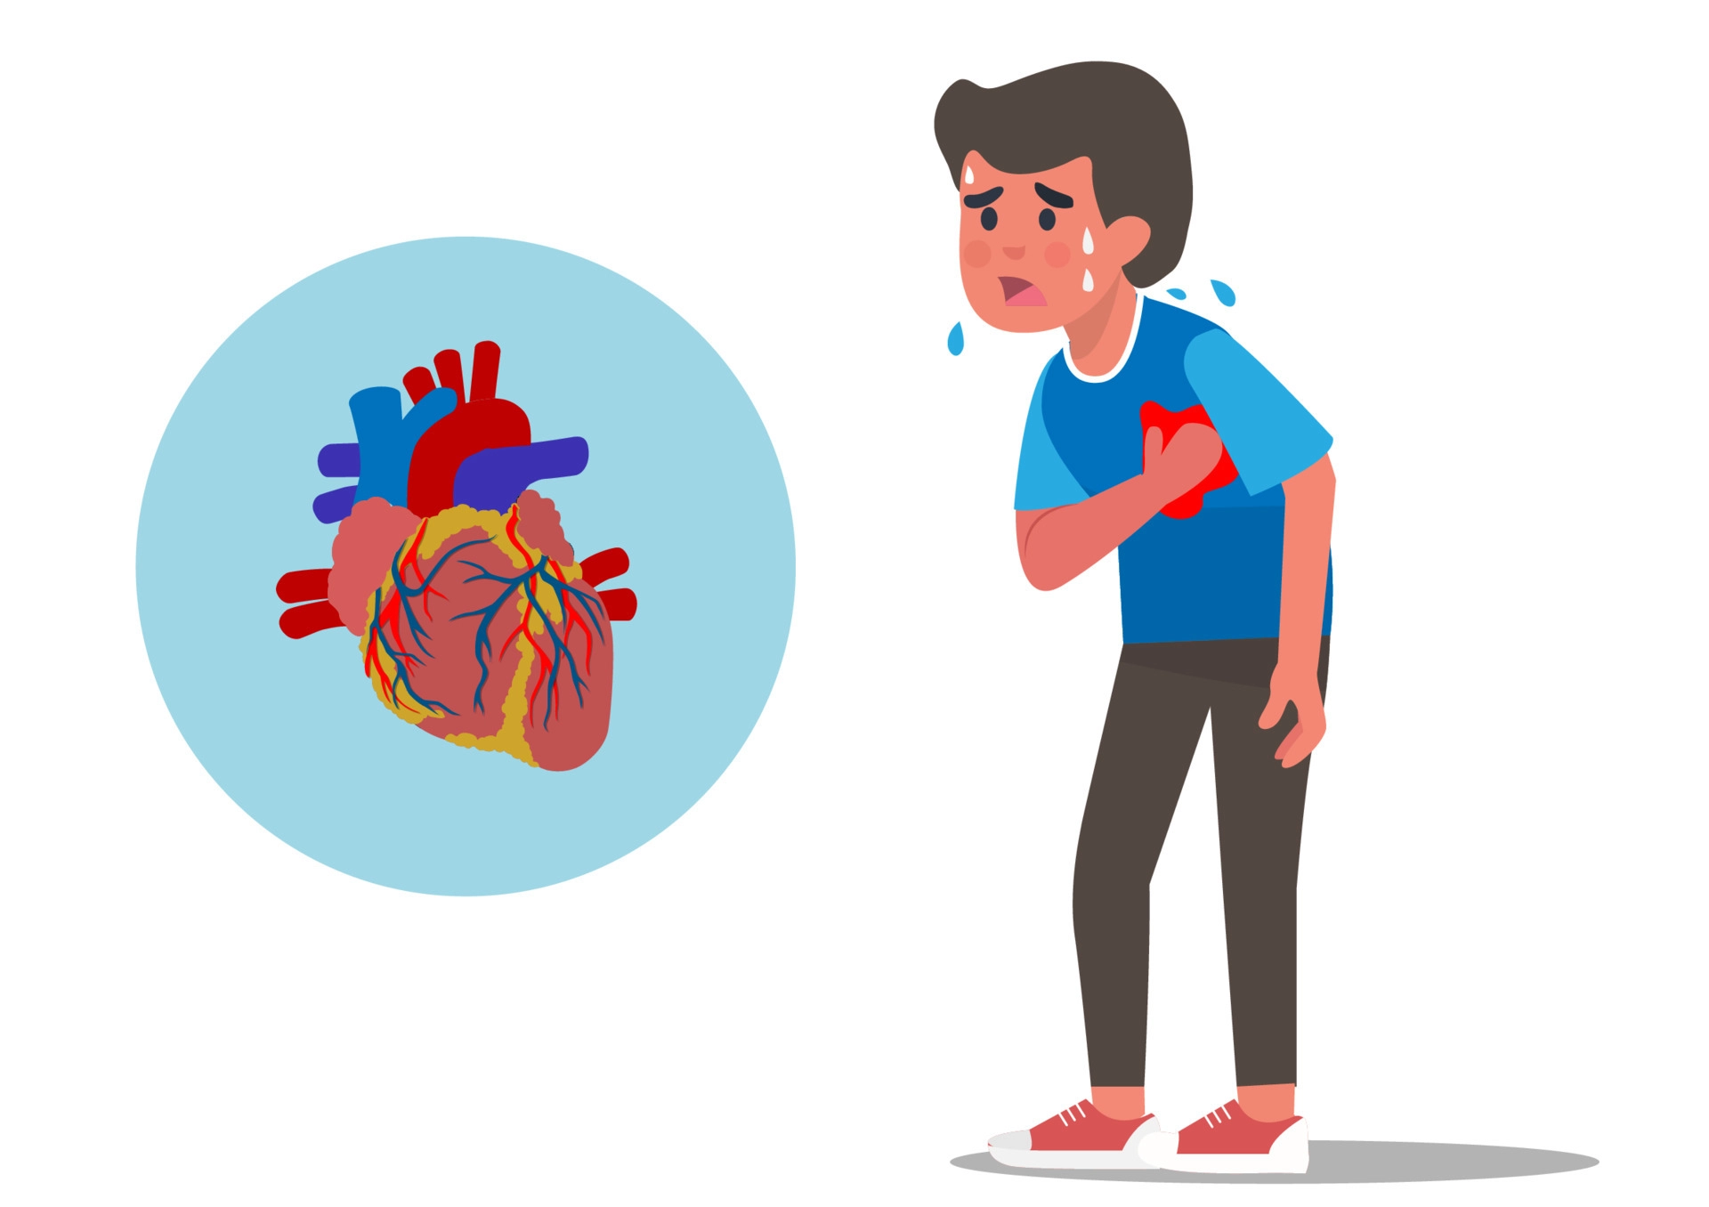
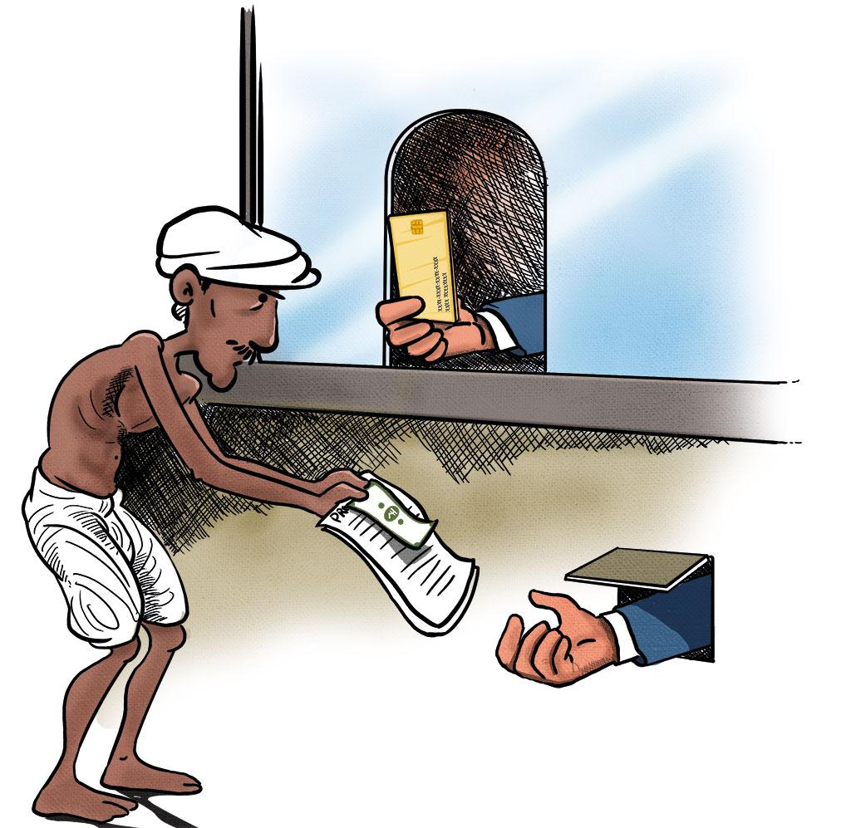
Problem Statement
Fraud Food
Health Issues
Heavy Loans by farmers
IT Department

Slide 3
ABSTRACT
There is a prevalence of food fraud in which unhealthy food is marketed as healthy, leading to serious health problems such as heart attacks, especially among young people. Additionally, many farmers are not receiving fair compensation for their crops, leading to financial difficulties and even suicides. However, blockchain technology can help to address these issues by enabling better monitoring and control of the food supply chain and ensuring that farmers receive adequate compensation, resulting in healthier food for consumers.
IT Department

Slide 4
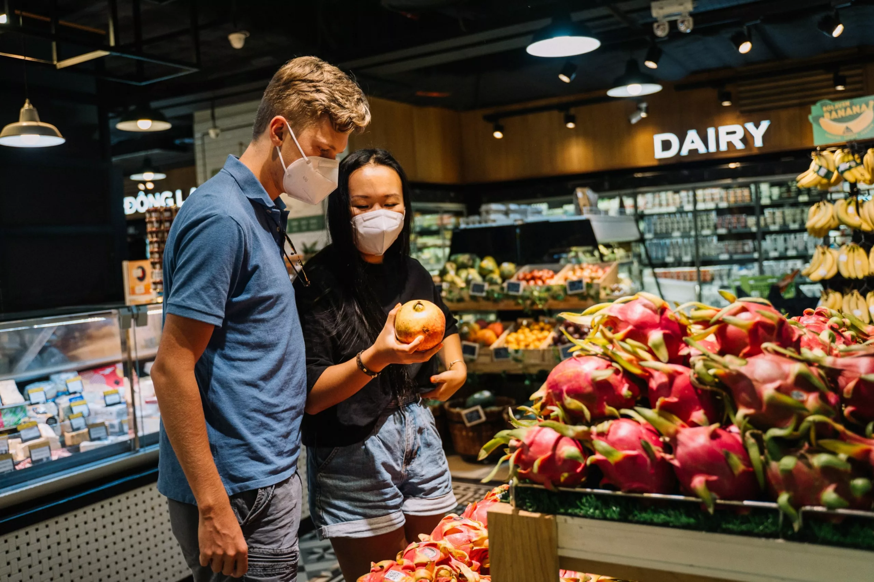
Existing System
In the traditional way of recording food details, it was done manually on a book or a register. The end user will not be able to access and verify whether the product is grown organically or not.
Few Drawbacks:
Anyone can able to change the data.
No Traceability.
No Transparency.
Trust issues for customers with the products.
IT Department

Slide 5
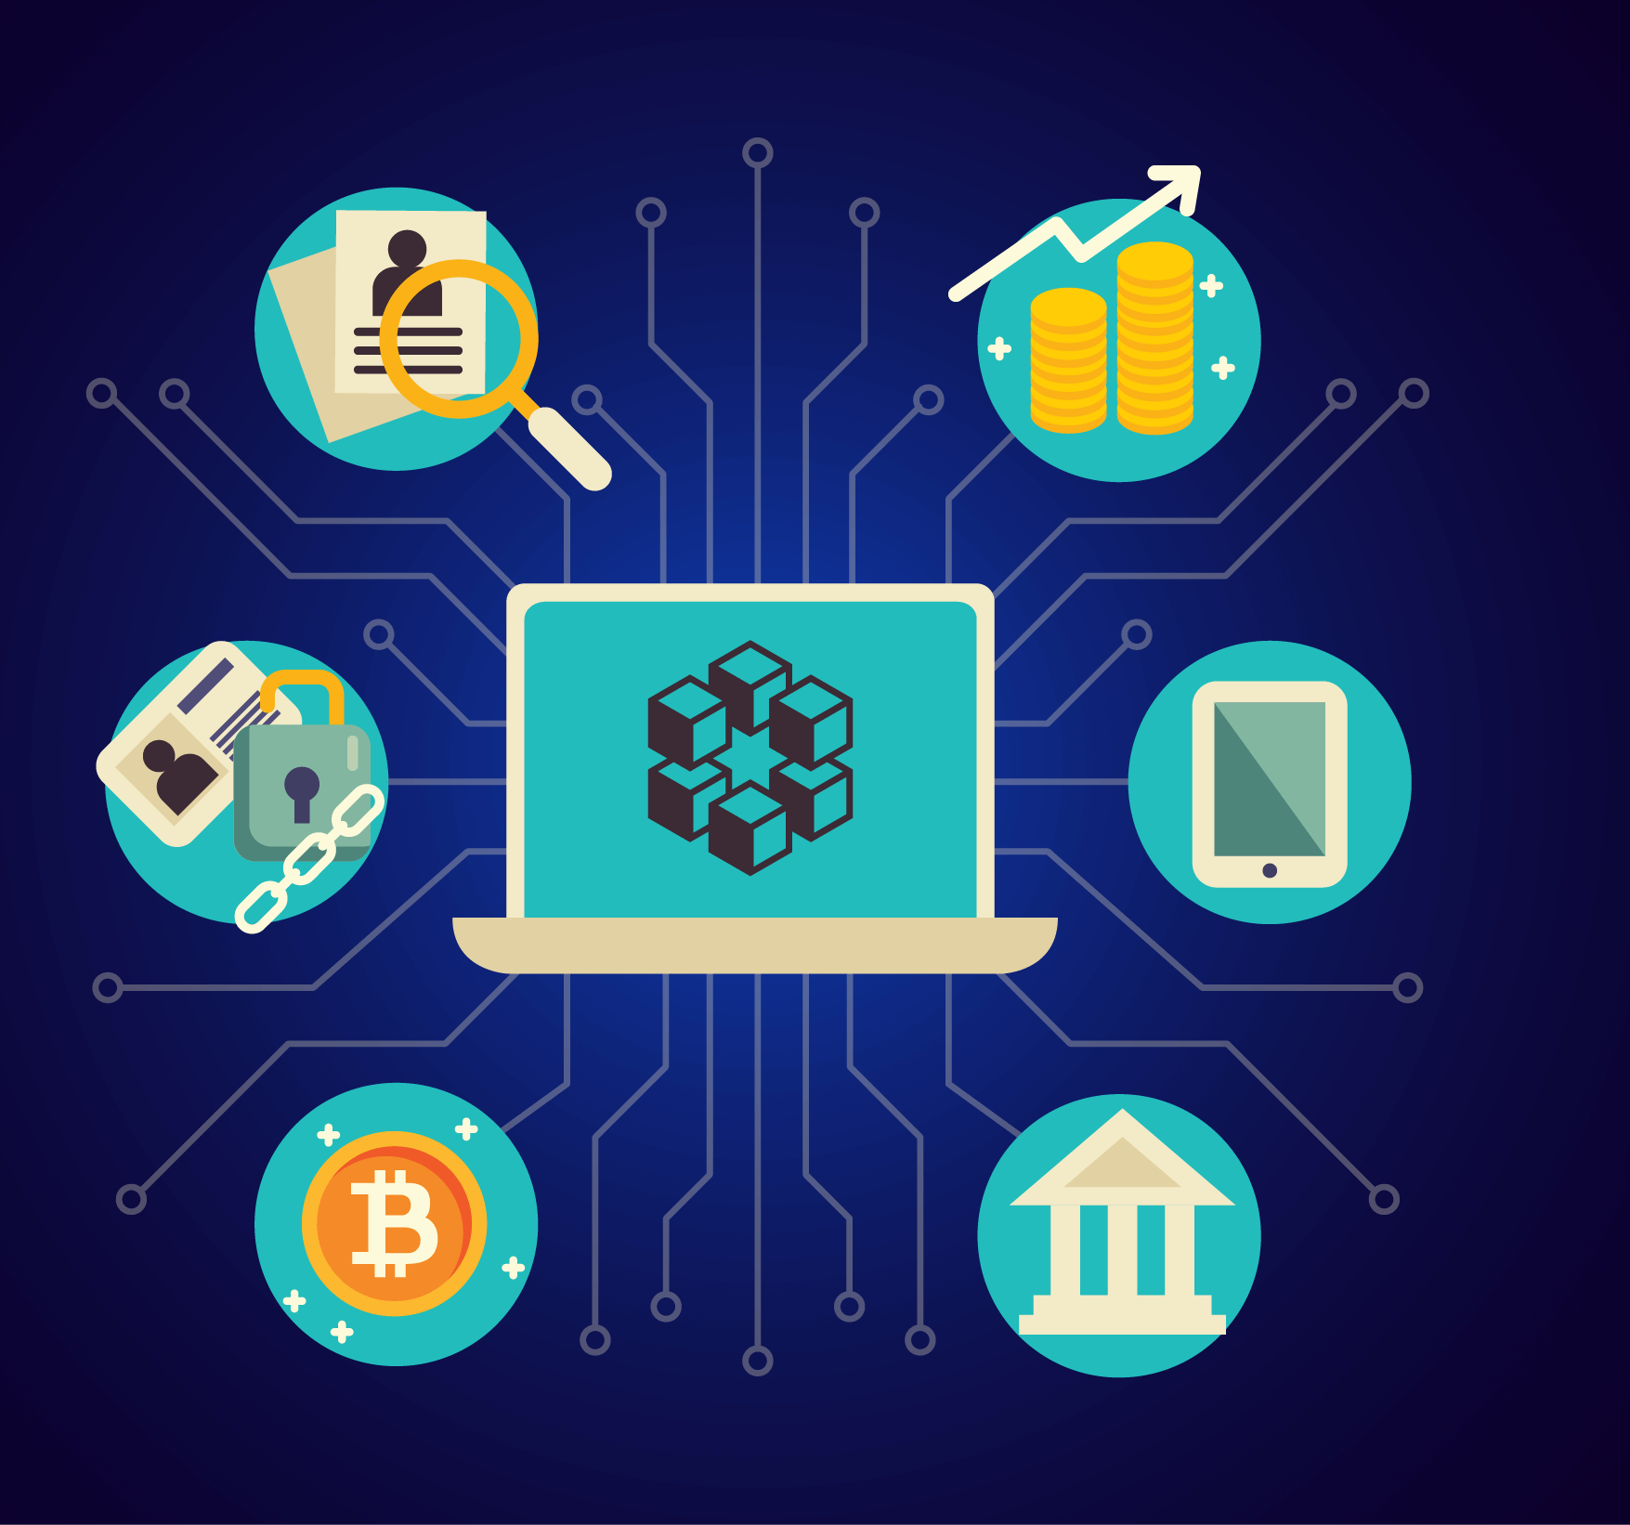
Proposed System
Since the supply chain is so fragmented, the transfer of credible information is slow and many times not to be found.
Most of the losses produced here are due to misinformation, miscommunication and lack of trust between the different tiers.
Introduction of blockchain can cause the fragmented nature of this supply chain to be simplified.
Every information related to the product is saved in to the blockchain that enables the user to trace-back whether the product is safe or not.
IT Department

Slide 6
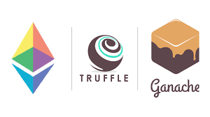
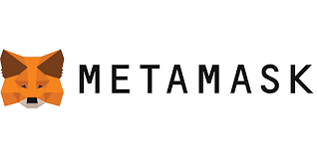
Software Requirements
Operating System
Coding Language
IDLE Tool
Tools for Deployment:
Ganache
Truffle
MetaMask
Nodejs
: Windows 11
: Solidity (v0.5.16)
: Visual Studio Code
: v7.5.0
: v5.6.6
: 10.14
: v18.12.1
IT Department

Slide 7
Hardware Requirements
Processor
Hard Disk
Mouse
RAM
Min Upload Bandwidth
Internet Connection
: AMD Ryzen 5
: 140 GB SSD
: Logitech
: 4 GB (Minimum)
: 1.7 Mbps
IT Department

Slide 8
Functional Requirements
The farmer should able to register his data in the blockchain.
The farmer should be able to enter his product details.
The Lab Technician should be able to approve the product.
The custmer is able to check the product details and its history.
The customer should be able to process the micro-funds to the farmer.
IT Department

Slide 9
Non-Functional Requirements
Data is immutable
Transparency of data
Portability of devices
Reliable
Security
IT Department

Slide 10
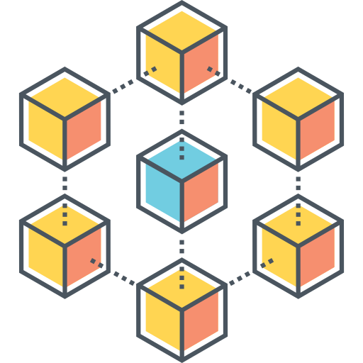


Smart Contracts in Blockchain Technology
USER
SMART CONTRACTS
BLOCKCHAIN TECHNOLOGY
A user-friendly interface allows the user to enter crop details for a blockchain-based crop management system.
Smart contracts facilitate the transaction and record the information on the blockchain, ensuring transparency and security for all stakeholders.
IT Department

Slide 11
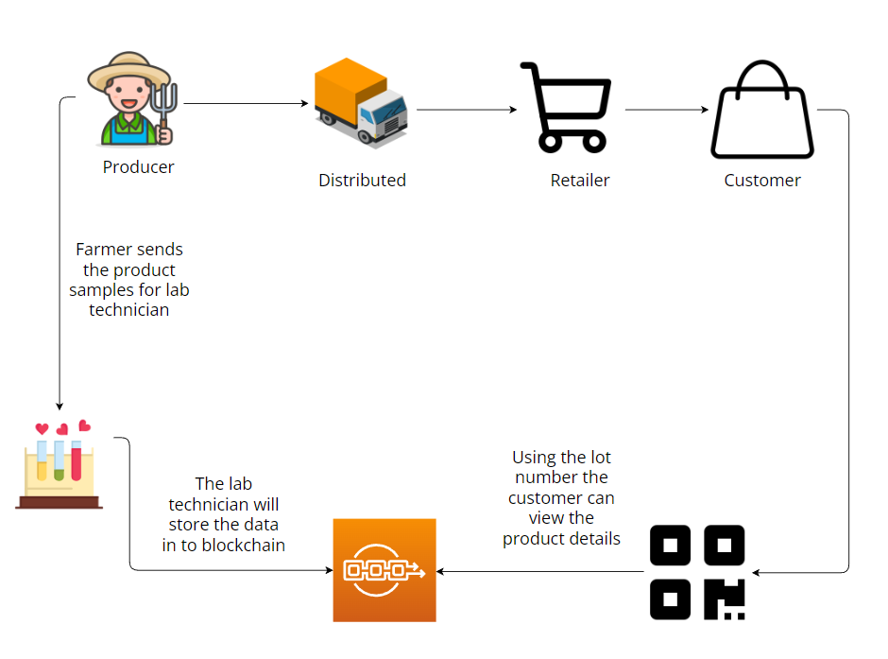
System Architecture
IT Department

Slide 12
UML DIAGRAMS
IT Department

Slide 13
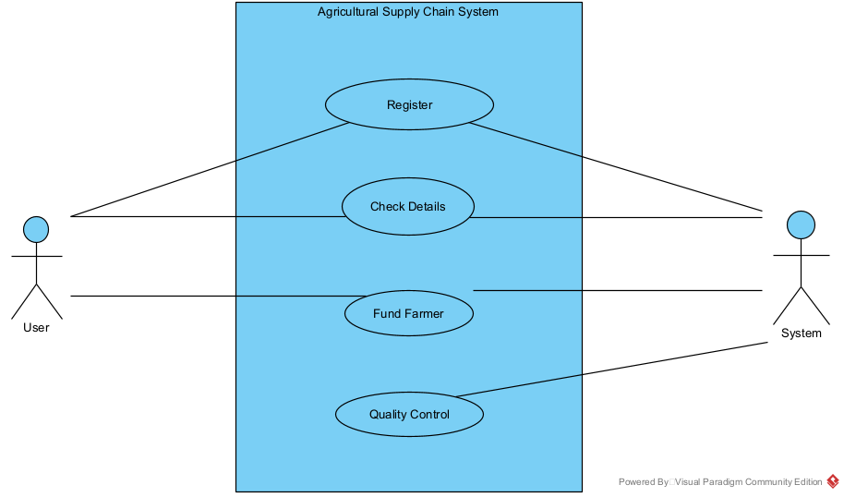
Use Case Diagram
IT Department

Slide 14
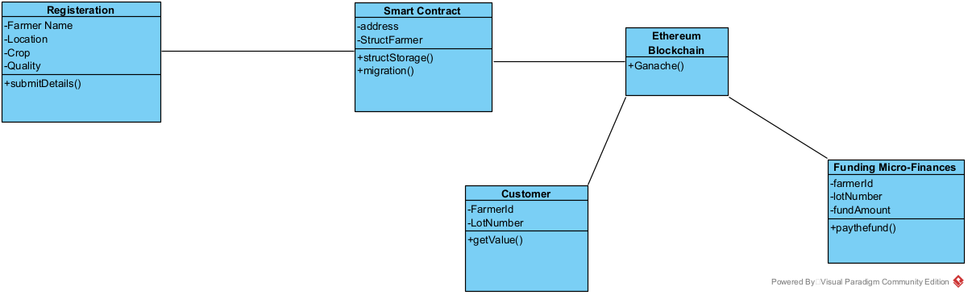
Class Diagram
IT Department

Slide 15
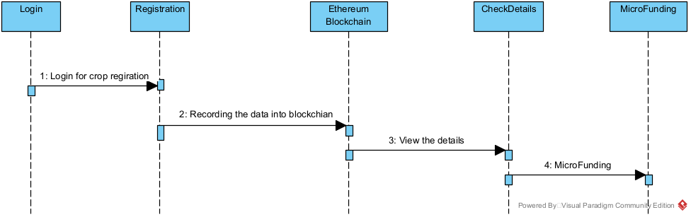
Sequence Diagram
IT Department

Slide 16
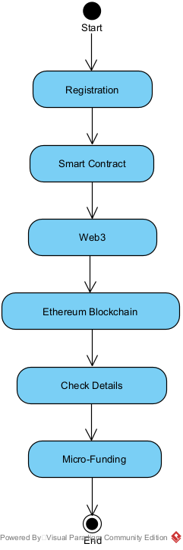
Activity Diagram
IT Department

Slide 17
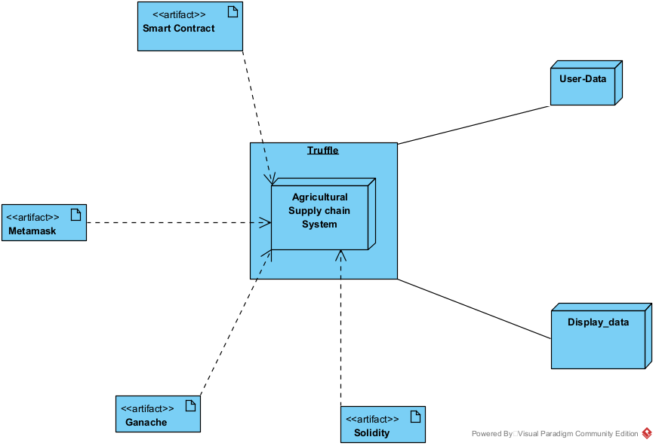
Deployment Diagram
IT Department

Slide 18
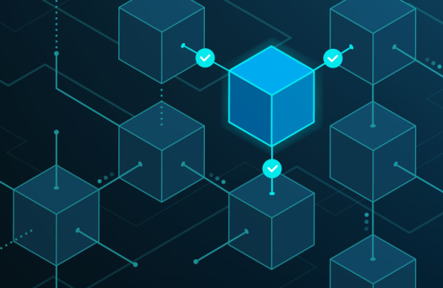
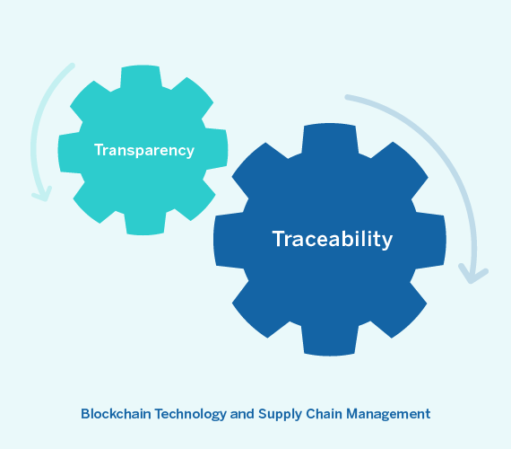
Blockchain Technology
We can solve all these issues with the help of blockchain technology.
What is Blockchain Technology?
A blockchain is a distributed database used to store and record transactions between parties in a secure and transparent manner.
Each block in a blockchain contains a record of multiple transactions and a unique digital signature that verifies the integrity and authenticity of the data.
Blocks in a blockchain are connected in a chronological chain, creating a tamper-proof and transparent record of all transactions on the network.
The use of blockchain technology can increase trust and transparency in digital transactions, reduce the potential for fraud or errors, and increase efficiency and security in a variety of industries and applications.
IT Department

Slide 19
Blockchain Technology
How does Blockchain Technology work in Supply Chain Management?
Once the produce is harvested and verified by a third-party certification agency, the smart contract is triggered to release payment to the farmer.
Smart contracts can verify product quality standards and trigger actions if they are not met, using IoT devices and sensors throughout the supply chain.
As the produce is transported and processed by various participants in the supply chain, the smart contract can track its location and status and automatically update the contract terms as necessary.
IT Department

Slide 20
Blockchain Technology
Benefits of using Blockchain Technology in SCM
Increased Transparency: Blockchain increases the transparency of the supply chain allowing anyone to know how products are developed.
Enhanced traceability: With the help of blockchain, anyone can trace the journey of the product.
Improved Efficiency: Blockchain digitizes manual processes in supply chain management to streamline operations and reduce costs and time, which increases efficiency
Enhanced Security: As blockchain is decentralized, it becomes difficult to hack, which means it is secure.
Increased trust: By providing a transparent, secure, and efficient supply chain, blockchain can help to build trust among all parties involved in the process, from suppliers to consumers.
IT Department

Slide 21
RESULT SCREENS
IT Department

Slide 22
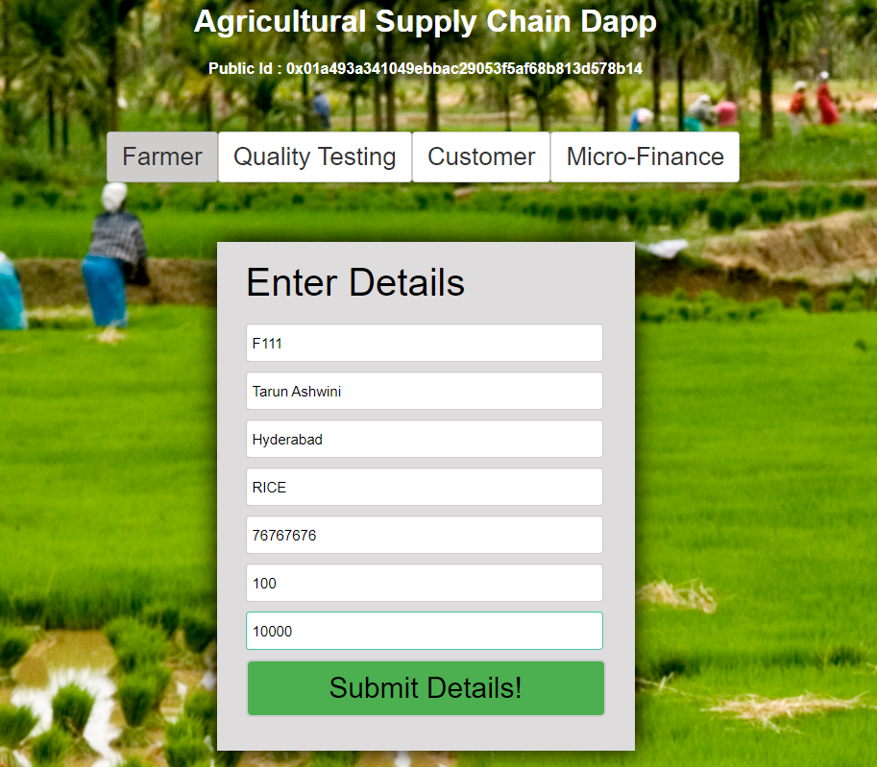
Product Registration Page
IT Department

Slide 23
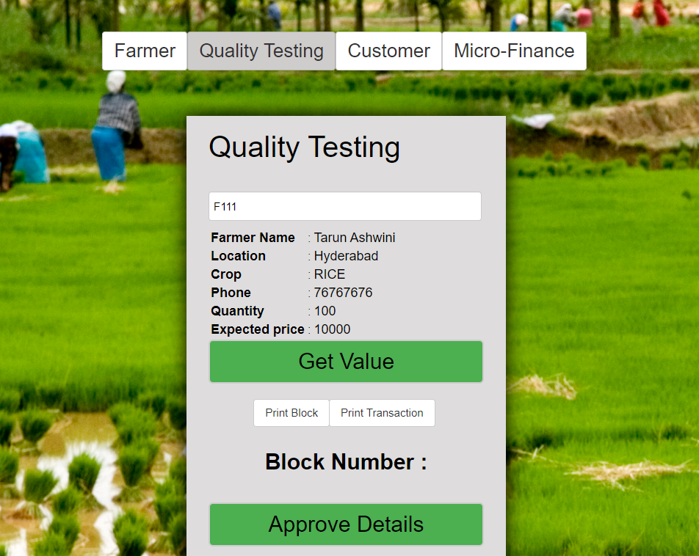
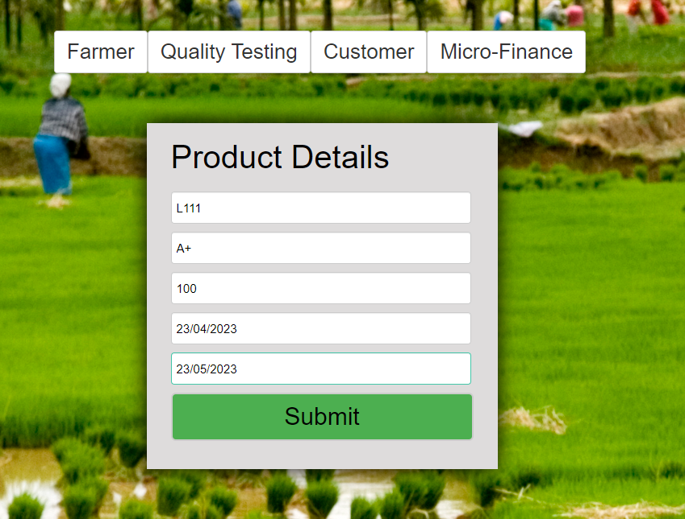

Quality Testing Page
Rama Krishna
Hyderabad
RICE
76767676
100 kg
10000
IT Department

Slide 24
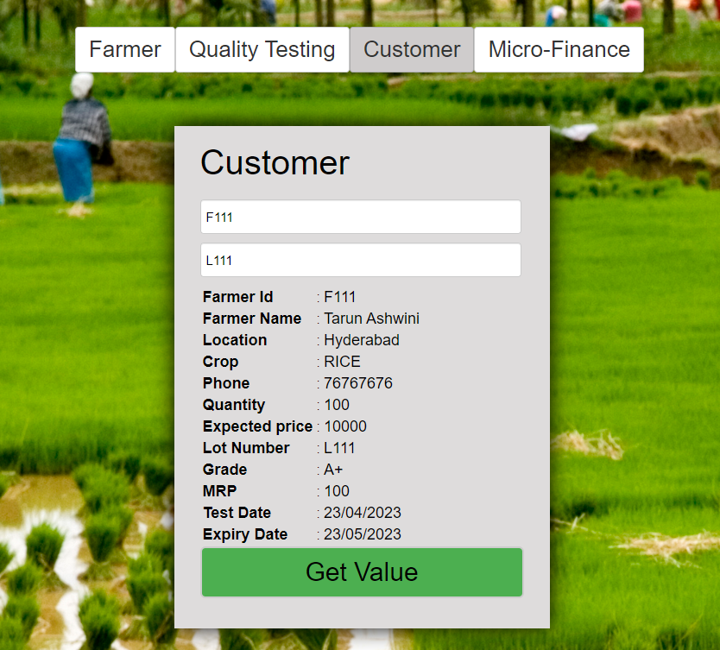
Customer Page
IT Department

Slide 25
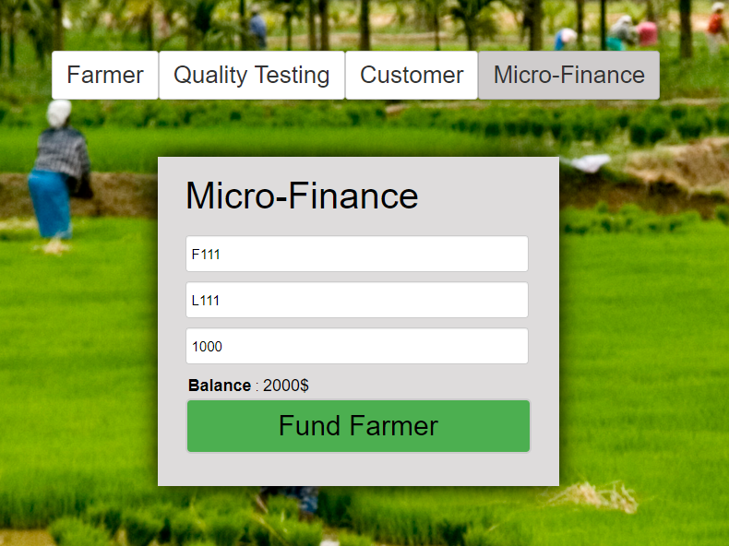
Micro-Finance Page
IT Department

Slide 26
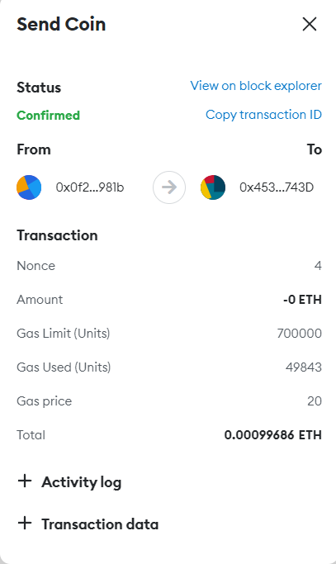
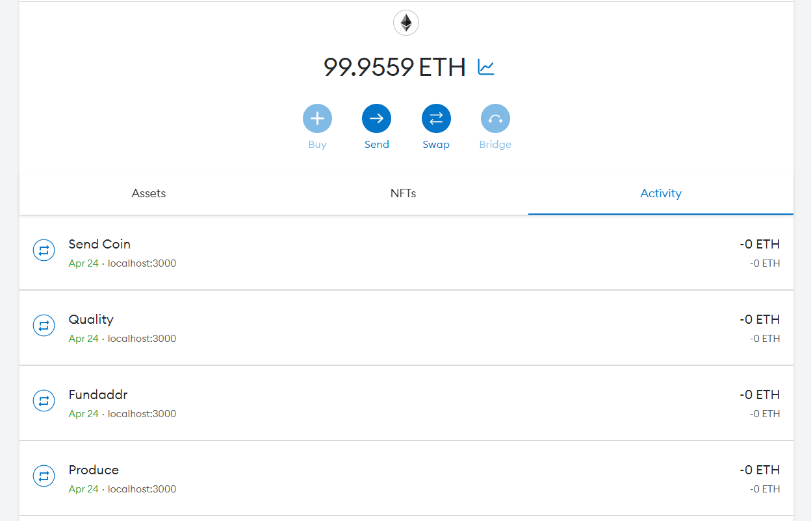
MetaMask Wallet
IT Department

Slide 27
Conclusion
Traditionally, product details have been recorded in physical books, leading to various issues like lost records, security concerns, and traceability problems. However, blockchain technology offers a solution to these issues by providing secure, traceable, and transparent records. This benefits all parties involved in the supply chain, from farmers who can demonstrate the quality of their goods and earn healthy profits, to retailers and customers who can confidently purchase healthy products. This enhanced trust between parties can lead to further collaboration and innovation in the industry.
IT Department

Slide 28
Future Scope
We can also add many features to this project and The potential of blockchain technology extends beyond supply chain management and can be applied to other areas like
E-Voting System
Healthcare record management
Intellectual property rights management
Gaming, and virtual asset ownership
IT Department

Slide 29
THANK YOU!
IT Department

